Slide 1


Designing a Community Based Intervention to Address a Social Determinant of Health in My Local Area
Presented by:
Badon Akter Suma
Roll:MOP00008 Batch:02
Jatiya Kabi Kazi Nazrul Islam University

Slide 2
Objectives
To know the health issues in my area
To design a community based intervention

Slide 3
Outlines
Identifying the Issue
Community Engagement
Intervention Design
Evaluation and Sustainability
Ethical Considerations

Slide 4
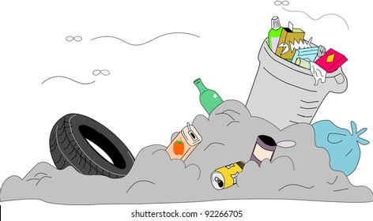
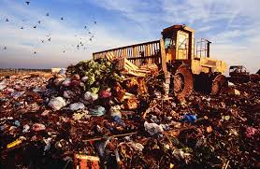
Identifying an Issue in My Local Area
My local area is Alohori Durgapur which is under Trishal Upazila in Mymensingh District. The issue in my local area is “improper disposal of waste.” Improper disposal of waste refers to the inappropriate and negligent handling, dumpling, or eliminating of trash in a way that harms the environment, human health, and safety
Improper disposal of waste can cause many serious health problems and harm the environment. When solid waste is handled and transported improperly it can contaminate the air, water and soil, have a negative impact on the environment and pose danger to people’s health.

Slide 5

Community Engagement Strategies
Media Campaign
Focus Group and Community Meeting
Door to Door Initiatives
Educational Institution and Youth Group

Slide 6

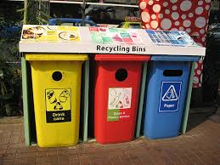

Intervention Design
Creation of Points for the Collection of Community Waste
Work together with the local government to set up particular places for the collection of waste that can be easily accessed to everyone. Provide different types of garbage such as recyclables, organic waste and non-recyclables marked containers
Knowledge and Awareness in the Community
Collaboration with the nearby educational institutions, community centers, and religious organization to conduct workshops and awareness session provide a crucial chance of educate the general population about the negative effects improper waste disposal has on the environment and human health

Slide 7


Intervention Design
Purchase Environmentally Friendly Goods
Search for an opportunity to purchase more environmentally friendly products so that one can get rid of those plastic pop bottles. Amongst them are coloring books, calendars, bottle openers, and many more
Recycling
Recycling is the process that generates new goods and materials from existing waste. Recycling materials include paper, tin, aluminum, plastic and many other things.

Slide 8
Waste disposal methods use and percentage
Action
Methods | Percentage
Burning waste | 2.1%
composing | 1.3%
Own land lift | 3.2%
Selling waste | 1.7%

Slide 10

Evaluation and Sustainability
It is necessary to keep a close eye on the process of implementation to make sure that the intervention’s timeline and activities are followed.
It is crucial to analyze changes waste to waste segregation, closing of open dumping locations, and involvement of the community in cleanup efforts
Level of community involvement, level of satisfaction with intervention efforts and areas needing improvement should be assessed
Community members need to be provided with the necessary tools to lead sustainable practices and take responsibility for waste management
Work together to develop recycling and waste collection programs that are sustainable with recycling centers and waste management agencies.

Slide 11
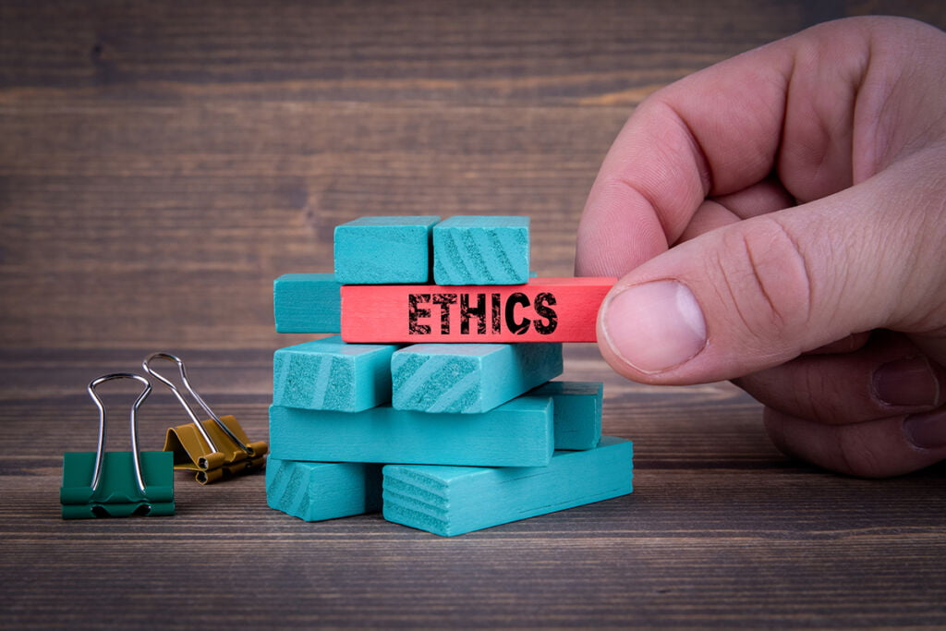
Ethical Considerations
Ensuring that every person in the community has equal access to the information, resources, and advantage of the intervention, irrespective of their socioeconomic background, gender, age or other factor.
Maintaining community members’ right to privacy and ensure the privacy of any personal data collected during the intervention
Preventing cultural imposition or intensively, the intervention design should respect and incorporate local cultural norms and practices.
Ensuring that the intervention’s objectives, funding source, and processes for making decisions are all transparent.
Avoiding letting the community, environment, or the people taking part in the intervention experience unnecessary harm by being engaged.
It is essential that intervention’s benefits are shared equitably while contributing toward the community’s wellbeing.

Slide 12
THANK YOU

